Slide 1
Module 2: Lesson 5 ADVOCACY

Slide 2
Enduring Understandings
Each person and group can find a way to work for justice.
We are one human family; our choices ripple a long way.
Deep convictions give rise to hope and courage.
Human rights and the rights of the Earth only exist if we claim and insist, through our thoughts, words, deeds, and laws.

Slide 3
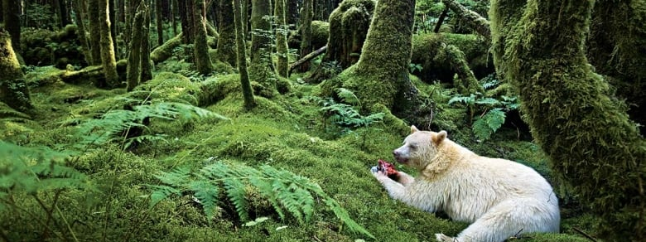
The fight to protect the Great Bear Rainforest in Canada
Notes:
Video (3:03) https://www.cbc.ca/news/canada/british-columbia/great-bear-rainforest-project-earns-environmental-group-100k-us-award-1.3793420

Slide 4
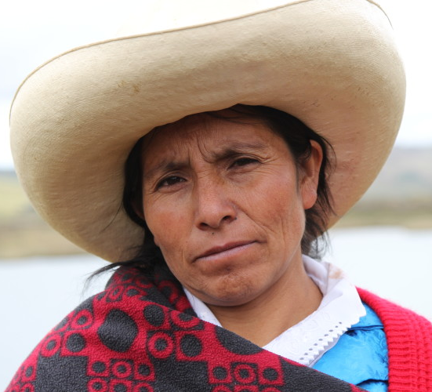
Maxima- defending the land and water in Peru (2:30)
https://www.youtube.com/watch?v=aQVpizVel4w
Notes:
https://www.goldmanprize.org/recipient/maxima-acuna/

Slide 5
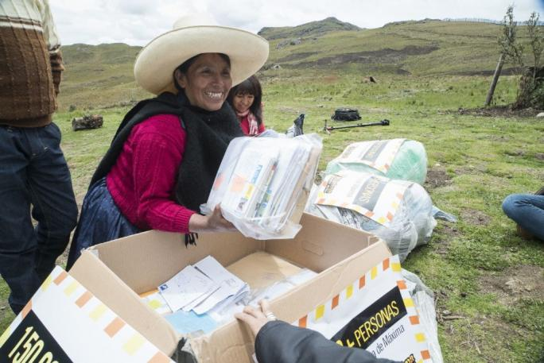
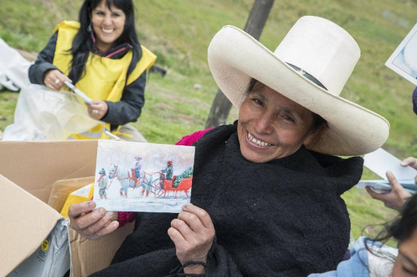
It made a difference.
Activists from Canada, the United Kingdom, Norway, France, Taiwan, Chile, New Zealand, Italy and Peru, among others, wrote to the Peruvian government as part of the global 'Write for Rights' campaign to protect Máxima Acuña and her family from threats of assault and intimidation. (Feb.2017)
Notes:
https://www.amnesty.ca/blog/150000-solidarity-messages-delivered-m%C3%A1xima-acu%C3%B1a-peru

Slide 6
“Destroying the rainforest for economic gain… is like burning a Renaissance painting to cook a meal.” E.O.Wilson

Slide 7
a future for the Amazon, a future for all

Slide 8
Why is a future for the Amazon
a future for all?
Maintaining biodiversity is essential for the web of life
Loss of rainforest heats up the earth (radiation of land)
Loss of the carbon sink (trees) means more carbon and less oxygen in the atmosphere (less transpiration)

Slide 9
Loss of forests changes amount of water vapour created as rivers in the sky; less rainfall means more dry areas.
Less water is produced for the rivers; less fresh water flows into the ocean to act like a cooling mechanism
Indigenous peoples and cultures have important knowledge and wisdom to share in these urgent times. Their lives and way of life matters.
Notes:
The degradation of Amazonia weakens its ability to mitigate climate change etc ..

Slide 10
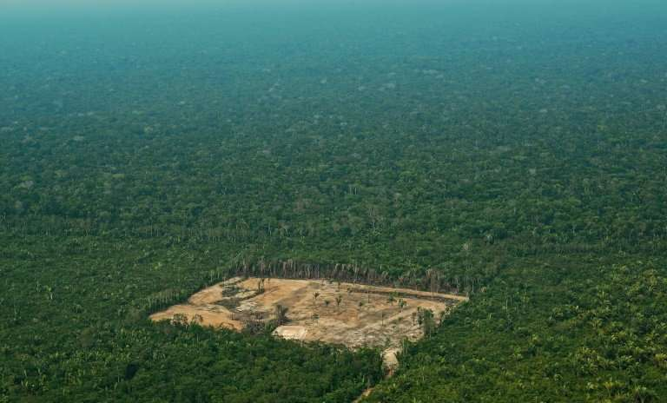
An example of global solidarity
https://www.youtube.com/watch?v=HPvi1oe-v5E
Notes:
Image credit: https://phys.org/news/2018-03-eu-hardwood-imports-fuel-amazon.html

Slide 11
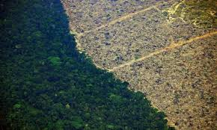
IAmazonia
This video motivates collective action from one side of the world to act in solidarity with another side of the world.
Why would Amsterdam care about the Amazon?
What details within this video were particularly inspiring?
And you? Why would you care about the Amazon?
Next steps?

Slide 12
What citizenship actions can we take?

Slide 13
Solidarity letters
Advocacy letters
We will invite parishioners, students, and the general public to sign the solidarity letter to two communities in Brazil who are defending their land in the Amazon.
It is also possible to sign the letter online: devp.org/act.
Collect the signed letters and send them to the national office of D&P by mail by April 2020 when the Regional Assemblies take place.
A Development and Peace young adult delegation will deliver the letters to the communities in Brazil in July.
With the signatures and letters collected, Development and Peace will put pressure on the elected Canadian government, Canadian embassies, the local and national governments in Brazil and the companies involved, by writing and publicizing advocacy letters, which will quote the number of Canadians who are concerned about the situation these Amazon defenders are facing.
We will use UNDRIP and the Voices at Risk Guidelines as a framework to insist that the rights of Amazon defenders must be protected.
Notes:
Elana

Slide 14
MP meetings
Meet with your federal MP and other federally elected officials and ask for their support.
Talk about the importance of protecting the Amazon and its defenders.
Further information and suggestions available on the document: Summary-Campaign Citizenship Actions
Notes:
Elana

Slide 15
Share the urgency of the message with others. Dialogue. Form groups.
Notes:
This image is a picture of two university students (Just Youth Club) tabling the campaign for other university students at St Thomas More College, University of Saskatchewan, Saskatoon.

Slide 16
Think-fast
Organize a Think-fast as a class or as a school, to raise awareness amongst others and to raise money to support Development and Peace actions of education, advocacy, and solidarity.

Slide 17
Why fundraising?

Slide 18
a future for the Amazon, a future for all

