Slide 1
Module 2: Lesson 4 UNDRIP

Slide 2
a future for the Amazon, a future for all

Slide 3
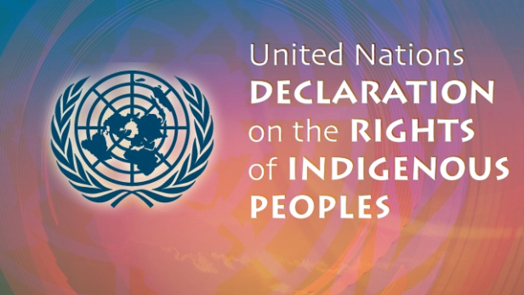
UNDRIP
The Declaration establishes a universal framework of minimum standards for the survival, dignity and well-being of the indigenous peoples of the world,

Slide 4
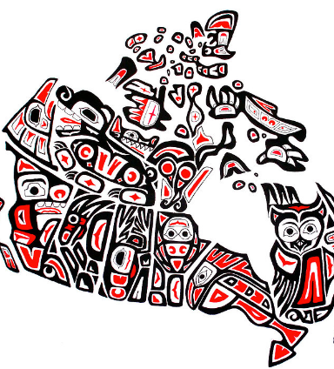
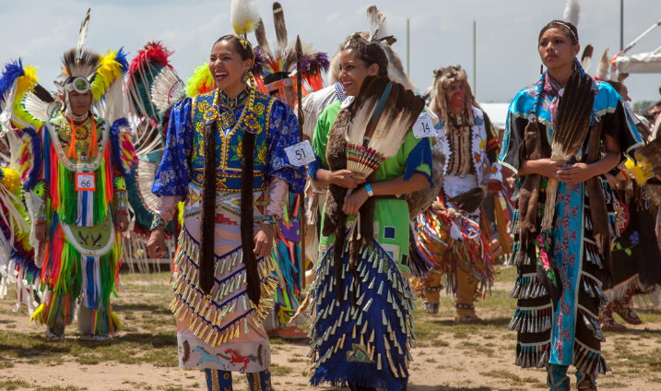
Who are the Indigenous Peoples?
Also known as First Nations peoples, Indigenous peoples are descendants of the original owners and caretakers of lands, before they were settled or colonized by others more recently.
They have strong and deep connections with their traditional territories, cultures and identities.
Notes:
Image credit http://www.eyeonthestorm.ca/news/shallow-thoughts-on-aboriginal-culture/
Image credit https://www.thecanadianencyclopedia.ca/en/article/powwow-dances

Slide 5
In a spirit of reconciliation and kinship
It is very important that all peoples, Indigenous and non-Indigenous, understand and support the work in countries around the world to fully implement UNDRIP as we seek reconciliation and a path forward together.
Notes:
Image credit: https://www.alternativesjournal.ca/community/blogs/current-events/why-does-canada-hate-indigenous-rights-one-word-oil

Slide 6
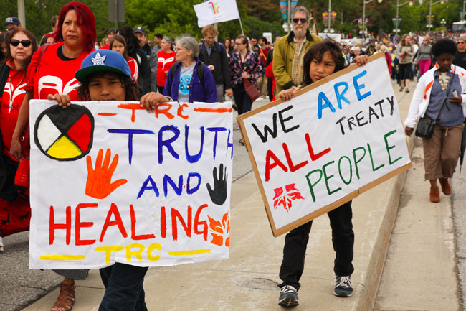
Example of an article in UNDRIP Article 18: Participation in decision-making Indigenous peoples have the right to take part in decision-making in all matters affecting them. This includes the rights of indigenous peoples to select who represents them and to have indigenous decision-making processes respected.
Notes:
Image credit: https://issuu.com/cigi/docs/undrip_implementation_special_repor
http://jesuits.ca/story?TN=PROJECT-20160108024801

Slide 7
What is needed?
Participation in Family and Community
What is happening in the Amazon biome
UNDRIP

