Slide 1
Module 2: Lesson 3 ACTIONS AND AGENTS OF SOLIDARITY

Slide 2
a future for the Amazon, a future for all

Slide 3
What does partnership mean?
Solidarity in human dignity
Solidarity in the right to live the fullness of life
Solidarity in the struggles for liberation
Development and Peace’ vision of partnership is born out of a relationship with the marginalized. Those who have been marginalized have the right to be the protagonists of their own history. They are the agents and creators of their own desired future.

Slide 4
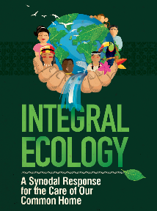
The Amazonian Partners with Development and Peace
I. REPAM
Rede Eclesial Pan-Amazônica (REPAM, the Pan-Amazonian Ecclesial Network) is a church network supported by the Latin American Bishops’ Conference. In the nine countries of the Amazon, it promotes human rights, helps marginalized communities resist injustice and draws global attention to the deteriorating condition of the Amazon and its Indigenous peoples.
Development and Peace-Caritas Canada is partnering with REPAM in their efforts to protect the ecology of the Amazon (which includes its primarily Indigenous peoples)

Slide 5
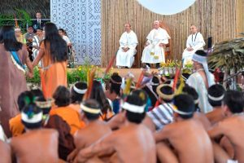
II. CIMI
-CIMI stands for Regional Missionary Indigenist Council
Cimi was created by the National Conference of Bishops of Brazil, to underscore the dignity and rights of indigenous communities, peoples, and organizations in Brazilian society.
It is an organization committed to the cause of indigenous people within a broader perspective of a democratic, just, multiethnic and multicultural society.

Slide 6
III. Comissao Pastoral de Terra (CPT)
CPT was created by the National Conference of Bishops of Brazil. It was instrumental in creating, supporting, and strengthening important peasant social movements in the last 50 years.
It acts in solidarity with rural peasant communities in their struggle for land, identity, and way of life. These communities persevere even as they experience threats, violence, and persecution.

Slide 7
The Mura People of Manaus

Slide 8
Solidarity letters
Advocacy letters
We will invite parishioners, students, and the general public to sign the solidarity letter to two communities in Brazil who are defending their land in the Amazon.
It is also possible to sign the letter online: devp.org/act.
Collect the signed letters and send them to the national office of D&P by mail by April 2020 when the Regional Assemblies take place.
A Development and Peace young adult delegation will deliver the letters to the communities in Brazil in July.
With the signatures and letters collected, Development and Peace will put pressure on the elected Canadian government, Canadian embassies, the local and national governments in Brazil and the companies involved, by writing and publicizing advocacy letters, which will quote the number of Canadians who are concerned about the situation these Amazon defenders are facing.
We will use UNDRIP and the Voices at Risk Guidelines as a framework to insist that the rights of Amazon defenders must be protected.
Notes:
Elana

