Slide 1
Module 2: Lesson 1 INTEGRAL ECOLOGY

Slide 2
a future for the Amazon, a future for all

Slide 3
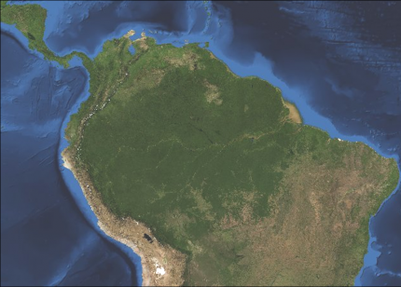
WHAT is meant by the Amazon basin?
The Amazon Basin is the part of South America that is drained by the Amazon River and its tributaries.
The Amazon rainforest lives within the basin.
Notes:
https://globalforestatlas.yale.edu/region/amazon

Slide 4
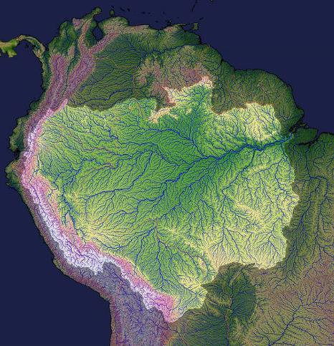
WHAT
What do you know about the Amazon River –
the world’s largest river?
Source?
in the highlands of the Andes
Length?
6992 km long (same distance as St. John’s Newfoundland to Vancouver, B.C.)
Empties into where?
the Atlantic Ocean
It is the largest river delta in the world.
Notes:
largest river in the world (6992 km) and most important in terms of flow = 209 000 m³/s St Lawrence = 1197 km, flow : 16 800 m³/s
(the longest river in the world is the Nile but the volume of the Amazon is larger)
Map credit: https://www.climatesignals.org/resources/map-amazon-river-basin

Slide 5
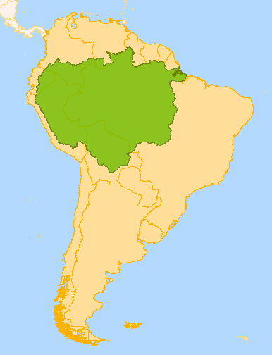
WHERE?
What countries have some part
in the Amazon basin?
The Amazon basin is in
9 Countries
Brazil (65% of the basin)
Columbia
Venezuela
Bolivia
Ecuador
French Guyana
Guyana
Peru
Suriname

Slide 6
How are rainforests (and in particular the Amazon rainforest) important?
1. Rainforests are our best defense against climate change.
Photosynthesis: the trees and plants in forests use carbon and produce oxygen as a result of photosynthesis (hence the term carbon sink for forests)
Water released by plants into the atmosphere through evaporation and plant transpiration influences world climate.
Tropical forests cool local climate and help generate rainfall, which affects weather across vast regions.
Notes:
Rainforests are linked to the global and regional climate regulation as they act as heat and water pumps. The forests simply store water and release it in the environment when the temperatures are high by drawing water from beneath the earth surface and transpiring it into the atmosphere to form clouds. The clouds then return to the ground as precipitation thereby cooling and stabilizing the environmental temperatures.
For this reason, rainforests are chief determinants of the water cycle. This is the reason clearing of rainforests seriously disrupts the water cycle and increases the chances of drought occurrence as well as the eventual formation of deserts. In West Africa for instance, the droughts in the south of the Sahara Desert is associated with the destruction of rainforests.
Tropical rainforests also regulate temperature increases linked to greenhouse gases (the green house effect – carbon dioxide in particular) and global warming. Essentially, they are termed as the “lungs of the planet earth” because they store carbon which is
https://www.eartheclipse.com/ecosystem/importance-and-reasons-for-loss-of-rainforests.html

Slide 7
As the forest is degraded and destroyed
-the temperature within the Amazon region rises,
-rainfall decreases.
The region could become a net source rather than a sink (storage) of carbon dioxide (CO₂), as industry is developed where forests used to be.
Notes:
Savannization means that what used to be the rainforest becomes a savannah- a wooded grassland

Slide 8
Why else are rainforests important?
2. Rainforests prevent flooding, soil erosion, and siltation.
The tree roots bind the soil together.
When the trees die they decay and release the nutrients in the soil.
In most cases, the clearing of forests leaves the soil bare coupled with a direct impact of heavy rain on the soil which results in flooding, serious soil erosion, and siltation.
Notes:
https://www.eartheclipse.com/ecosystem/importance-and-reasons-for-loss-of-rainforests.html

Slide 9
Why else are rainforests important?
3. Sources of Medicine
Less than 1% of the world’s rainforests have been explored and tested for their pharmaceutical or medicinal components
However, 25% of modern medicines have their origin in the rainforest: treatments to leukemia, anti-malarial drugs, high blood pressure, anti-inflammatory drugs, mental illness and much more have all been derived from the rainforests
Notes:
Source: https://www.eartheclipse.com/ecosystem/importance-and-reasons-for-loss-of-rainforests.html

Slide 10
Why else are rainforests important?
4. Sources of food diversity and industrial products
spices, nuts, bananas, coffee, rice, cocoa
industrial raw materials such as fibres, resins, dyes and rubber all originate from the tropical rainforests.
Notes:
https://www.eartheclipse.com/ecosystem/importance-and-reasons-for-loss-of-rainforests.html

Slide 11
Why else are rainforests important?
5. Biodiversity
Most rainforest have over 60 million years of plant and animal species evolution that has brought about a huge variety of complex ecosystems and biodiversity.
Ecologists and environmentalists estimate that we are losing entire species on a daily basis due to the destruction of the rainforests.
Notes:
https://www.eartheclipse.com/ecosystem/importance-and-reasons-for-loss-of-rainforests.html

Slide 12
Why else are rainforests important?
6. They provide homes and sustain livelihoods
for indigenous peoples
Tens of thousands of indigenous people have lived in harmony with the rainforests for centuries, depending on it for their medicines, food, and shelter.
Out of kinship, it is important to respect and protect the language, culture, traditional teachings, lives and livelihoods of those who make the rainforest their home.
Notes:
https://www.eartheclipse.com/ecosystem/importance-and-reasons-for-loss-of-rainforests.html

Slide 13
Why else are rainforests important?
7. Rainforests and all within them are part of God’s creation,
intricately woven into the large web of sacred beauty in the world.
They are not valuable because we say so. They are valuable because God created them.
“As part of the universe, called into being by one Father, all of us are linked by unseen bonds and together form a kind of universal family” (LS 89)
Notes:
https://www.eartheclipse.com/ecosystem/importance-and-reasons-for-loss-of-rainforests.html

Slide 14
The Amazon Rainforest
Amazon lungs of our planet BBC
This 4 minute video was released in 2014. In the past few years, deforestation in the Amazon region has increased at an alarming rate.
Notes:
https://www.eartheclipse.com/ecosystem/importance-and-reasons-for-loss-of-rainforests.html

Slide 15
What is going on in the Amazon rainforest right now?

Slide 16
What is meant by integral ecology in Laudato Si’?
Integral ecology recognizes that human culture is connected to all environments: social, political, spiritual, economic, and natural within a global living system that is all inter-connected. Everything is inter-related; the problems of our times can only be solved through an integrative understanding and effort.
As an example, if we want to know “why a given area is polluted,” we must study “the workings of society, its economy, its behavior patterns, and the ways it grasps reality.” “Strategies for a solution demand an integrated approach to combating poverty, restoring dignity to the excluded, and at the same time protecting nature.” (LS )

