Slide 1
Module 1: Lesson 6 CST: THE POOR

Slide 2
Notes:
http://stbasiltoronto.org/event/introduction-to-catholic-social-teaching/

Slide 3
Preferential Option for the Poor and Vulnerable
This means that we, as a church (the people of God), make a choice to put the needs of society’s most poor and vulnerable members first among all social concerns.
Repeatedly throughout the Bible and centrally in the gospels, God calls humanity to place the needs of the poor and vulnerable first. Why?
Notes:
https://medium.com/@NorCollective/community-rocks-larche-london-f0473377fadf Image of a l’Arche home in London, England
Answer to question: Simply put, their need is greater. “Choosing to defend poor and vulnerable people does not imply that they are more valuable. Society is called to place the needs of the poor and vulnerable first in the same way parents pay special attention to a sick child. The parents do not necessarily love the sick child more than the other children, but they make the sick child their top priority because of that child’s greater need.” Living Justice and Peace, p. 65, St Mary’s Press ©2008)

Slide 4
Preferential Option for the Poor and Vulnerable
Preferential Option for the Poor and Vulnerable
Notes:
Catholic Relief Services in the USA is a member of Caritas Internationalis, just as Development and Peace is in Canada.

Slide 5
Questions
Jesus: born wealthy? born poor?
What does this tell us about God?
Explain the meaning of “Whatsoever you do to the least of my brothers and sisters, you do to me.” (Matthew 25:40) What then is the lens we are asked to use in all of our interactions with others?

Slide 6
Another question
Archbishop Tagle says “When we encounter the poor, let us encounter them as a fellow poor person not from a place of superiority.”
This is not so much about a lens as it is about a mirror. What does it mean to use a mirror in your interactions with others?

Slide 7
More Questions
Who are the poor in our society?
who are the really marginalized?
who is vulnerable?
who is forgotten by society?
The speaker says “We should allow what we see and what we know to really touch us.” Why would that make a difference?

Slide 8
One more Question
We are encouraged to believe that this theme is not too big or hard for us to respond to. Instead, what does the film say we could choose to do?
Be charitable to the poor – give to organizations that care for the poor, give directly to the poor
Learn to see the poor as our brothers and sisters, bound together in kinship (the lens we use). They are part of our community of concern, rather than “those people”
To encounter and come to know the poor—shaking hands with them, touching them, coming into physical space with them. Being kin.
We need to examine what systems and policies keep the poor – poor, and choose actions that can help propel change.

Slide 9
Systems and Policies
“We are called to address both immediate needs and systemic problems, to look at the person in front of us and give them what they need in that moment, but also to say “Why is this person in this place? What has happened in our society? What are the larger issues at work and how can we address those larger issues?”
Most often, people do not CHOOSE to be poor. They are made poor and kept poor by systems and policies in society.”

Slide 10
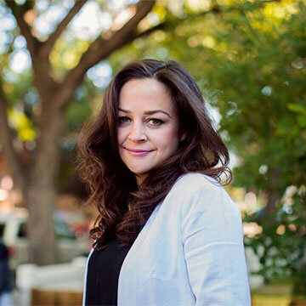
Katelyn Robertson: from a baby to Holy Cross grad to social work to Executive Director of Sanctum
Saskatchewan’s first HIV Transitional Care Home opened in November 2015
Sanctum Care Group is made up of interagency professionals who work directly with populations affected by HIV, addictions, mental health Issues, homelessness, and poverty.
https://www.youtube.com/watch?v=w74GkSBOFoc

Slide 11
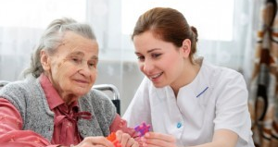
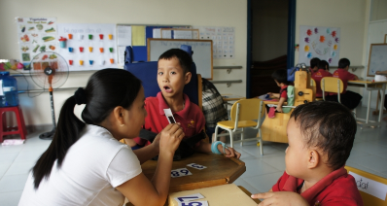
Policies and Systems: the journey towards justice
Notes:
Image Credit: care provided for the elderly https://www.homecareassistance-toronto.com/home-care-resources/hospice-to-homecare.html
Image credit: Special Needs Integration - http://oivietnam.com/2016/09/someone-special/
Photo credit: pollution- https://thenarwhal.ca/topics/environmental-issues-canada/

Slide 12
You have a voice. You can choose to act.
“We ought to sharpen the awareness of our duty of solidarity with the poor, to which charity leads us. This solidarity means that we make ours their problems and their struggles, that we know how to speak with them.
This has to be concretized in criticism of injustice and oppression, in the struggle against intolerable situations that the poor person often has to tolerate, in the willingness to dialogue with the groups responsible for that situation in order to make them understand their obligations.”
(Document on the Poverty of the Church, no. 10, from the New Dictionary of Catholic Social Thought,
edited by Judith A Dwyer. ©1994 by The Order of Saint Benedict, Collegeville, MN)

